Slide 1
Data Visualization with Tableau – Level 1
QCL Workshop Series
#Data #Visualization and #Tableau
Instructors: Dr. Jeho Park and Cindy Cheng

Slide 2
Make sure you are signed-in

Slide 3
Agenda
What is Tableau
Tableau Desktop Workspace
Connecting Data to Tableau
Data Relationships
Let’s make some graphs
Hands-on exercise

Slide 4
After this workshop, you will be able to…
Understand the fundamentals of data visualization
Connect data sources to Tableau
Create different worksheets to visualize insights of the data
Create Tableau Dashboard showing meaningful data visualization
Share Tableau Dashboard on Tableau Public/Online

Slide 5
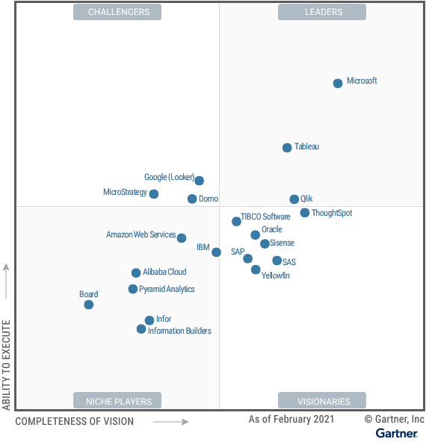
What is Tableau?
Magic Quadrant for Analytics and Business Intelligence Platforms
Tableau software was found in 2003
Tableau is one of the fastest evolving business intelligence and data visualization tools.
Source: Gartner (February 2021)

Slide 6
Cycle of Visual Analytics

Slide 7
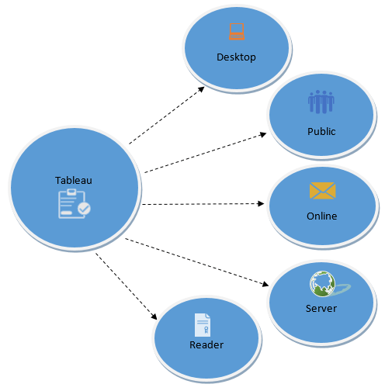
Tableau Product Suite
Tableau Desktop
Tableau Public
Tableau Online
Tableau Server
Tableau Reader
Source: guru99.com

Slide 8
Data Analytics in Tableau
Developer Tools: The Tableau tools that are used for development such as the creation of dashboards, charts, report generation, visualization fall into this category. The Tableau products, under this category, are the Tableau Desktop and the Tableau Public.
Sharing Tools: As the name suggests, the purpose of the tool is sharing the visualizations, reports, dashboards that were created using the developer tools. Products that fall into this category are Tableau Online, Server, and Reader.

Slide 10
What can you do with Tableau?
https://public.tableau.com/en-us/s/gallery/analyzing-ums?gallery=votd

Slide 11
Installing Tableau
Install the free trial of Tableau here:
https://www.tableau.com/products/trial
To continue using Tableau after the trial students and instructors can apply for a free license here:
https://www.tableau.com/academic
Notes:
Add how to get student/instructor license

Slide 12
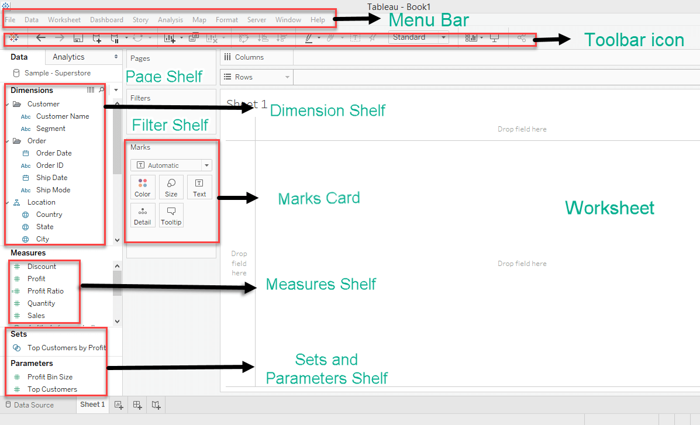
Tableau Desktop Workspace

Slide 13
Tableau Desktop Workspace Cont’d
Menu Bar: It consists of menu options such as File, Data, Worksheet, Dashboard, Story, Analysis, Map, Format, Server, and Windows. The options in the menu bar include features such as file saving, data source connection, file export, table calculation options, and design features for creating a worksheet, dashboard, and storyboard.
Toolbar Icon: Toolbar icon present below the menu bar can be used to edit the workbook using different features such as undo, redo, save, new data source, slideshow and so on.
Dimension Shelf: The dimensions present in the data source can be viewed in the dimension shelf.
Measure Shelf: The measures present in the data source can be viewed on the measure shelf.
Sets and Parameters Shelf: The user-defined sets and parameters can be viewed in the sets and parameter shelf. It can also be used to edit the existing sets and parameters.
Page Shelf: Page shelf can be used to view the visualization in video format by keeping the relevant filter on the page shelf.
Filter Shelf: The filters that can control the visualization can be placed on the filter shelf, and the required dimensions or measures can be filtered in.
Marks Card: Marks card can be used to design the visualization. The data components of the visualization such as color, size, shape, path, label, and tooltip used in the visualizations can be modified in the marks card.
Worksheet: The worksheet is the place where the actual visualization can be viewed in the workbook. The design and functionalities of the visual can be viewed in the worksheet.

Slide 14
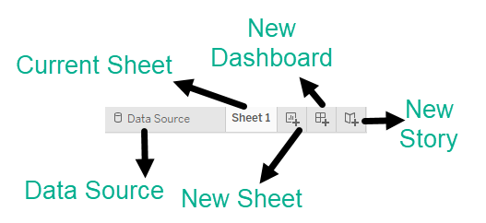
Tableau Navigation
Current Sheet:
Current Sheet can be viewed with the name of the sheet. All the sheets, dashboards and story board present in the workbook can be viewed here.
New Sheet:
The new sheet icon present in the tab can be used to create a new worksheet in the Tableau Workbook.
New Dashboard:
The new dashboard icon present in the tab can be used to create a new dashboard in the Tableau Workbook.
New Storyboard:
The new storyboard icon present in the tab can be used to create new storyboard in the Tableau Workbook.

Slide 15
Check point:
Locate Menu bar, Tool bar, Dimensions, Measures, Filter Shelf and Marks Card in the Workspace.
Know where is Data Source, Current Sheet, New Sheet, New Dashboard and New Story in the Navigation

Slide 16
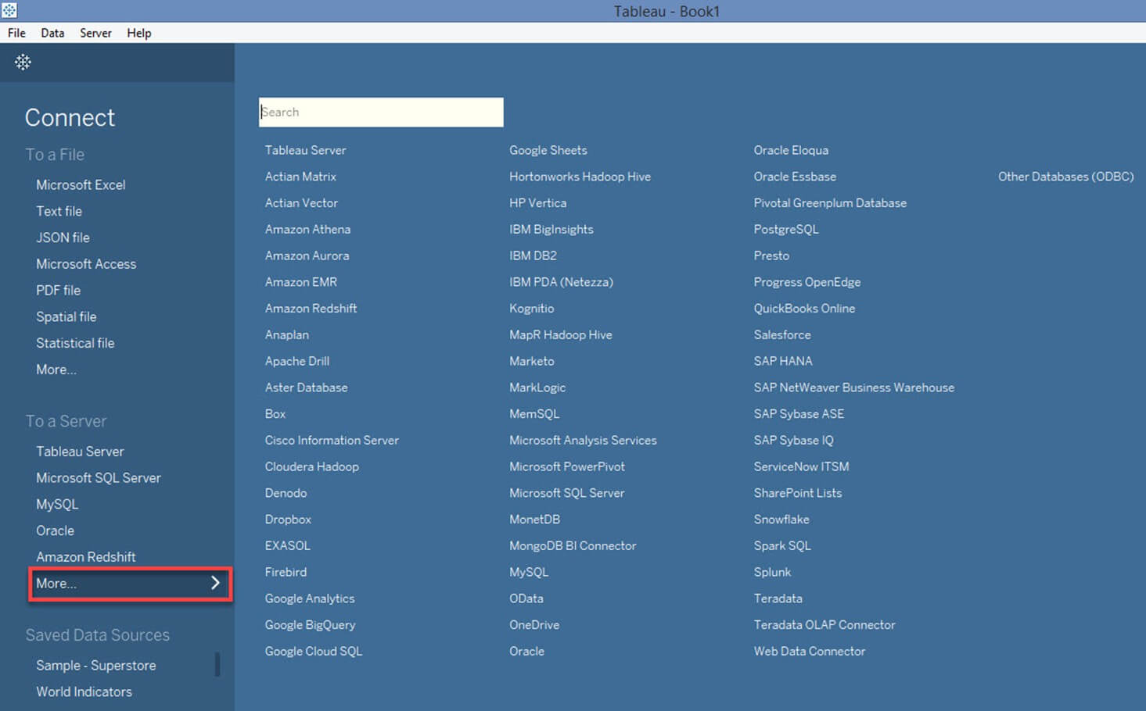
Tableau Data Connections

Slide 17
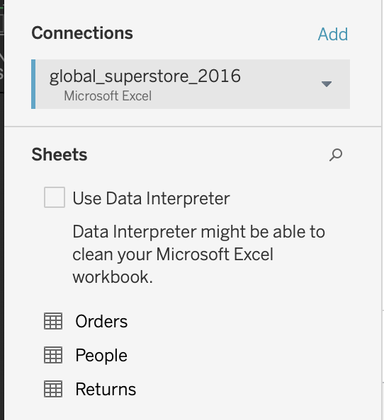
Connect Excel to Tableau
Click on Microsoft Excel option in the data tab then select “global_superstore_2016.xlxs.”
Once selected, the sheets in the Excel file will show on the left side of the workspace.

Slide 18
Data Repo
https://github.com/CMC-QCL/Intro-Tableau-L1/tree/master/Tableau%20Workshop%20Edits

Slide 19
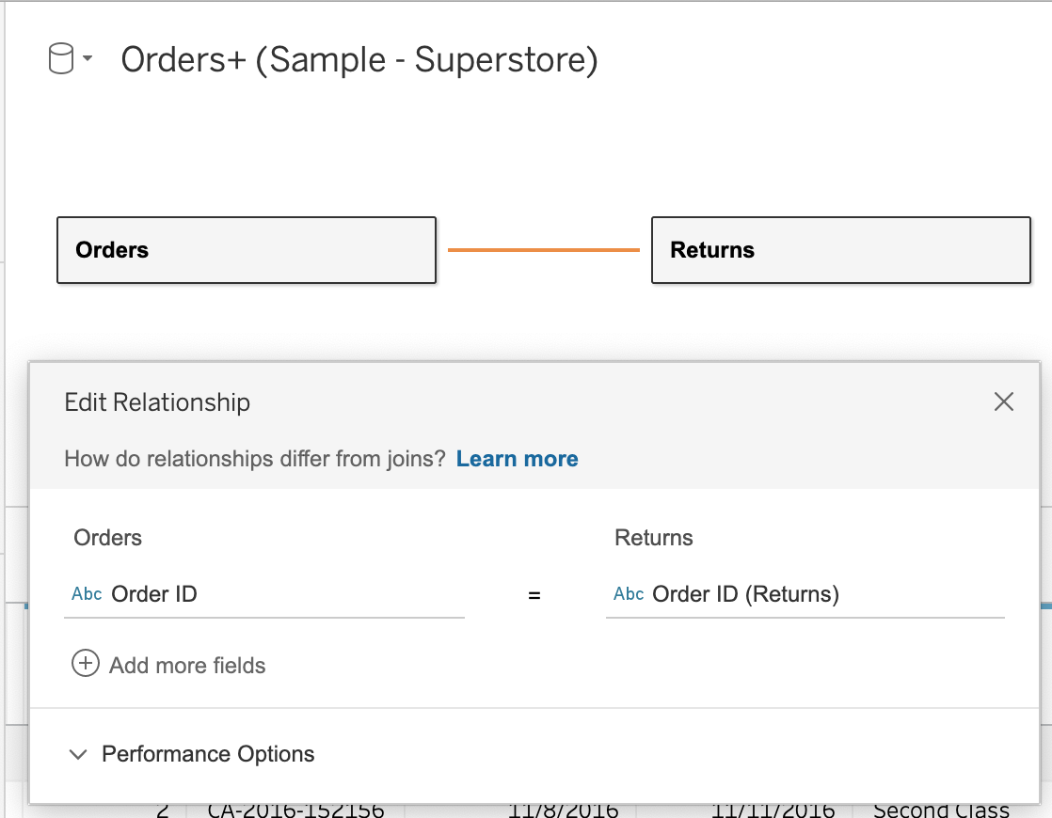
Data Relationship
A relational Database/Excel file consists of multiple Tables/sheets. These multiple tables/sheets can be connected to each other in Tableau. Relationship is defined on matching fields, so that during analysis, Tableau brings in the right data from the right tables at the right aggregation to build visualization.
Under Data Source, let’s build a relationship between Orders and Returns by drag and drop.

Slide 20
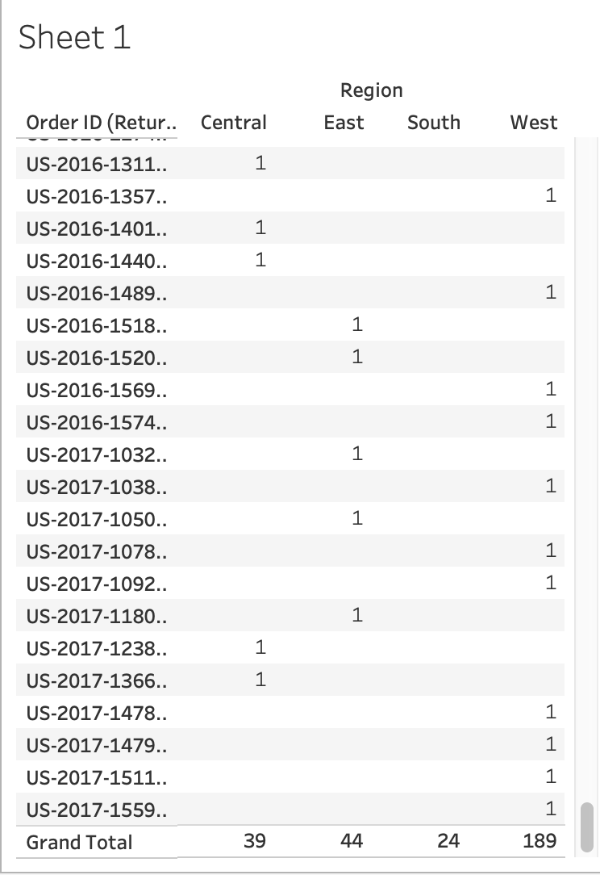
Orders + Returns Example
With the relationship between Orders and Returns created, what is the answer to the question of “Which region has the greatest number of returns?”
Answer the question by clicking on Sheet 1, drag and drop Region to Columns followed by Order ID (Returns) to Rows. Then go to Analysis -> Totals -> Show Column Grand Totals

Slide 21
Check point: Looking at the global_superstore_2016 data, what other relationship(s) can you identify? What does the relationship(s) tell you?
Look at the Orders, Returns and People sheets to see what interests you.
Once the relationship is formed, drag and drop into worksheet.
Enter your answer(s) in the chat, raise your hand or unmute.

Slide 22
Visualizing Data

Slide 23
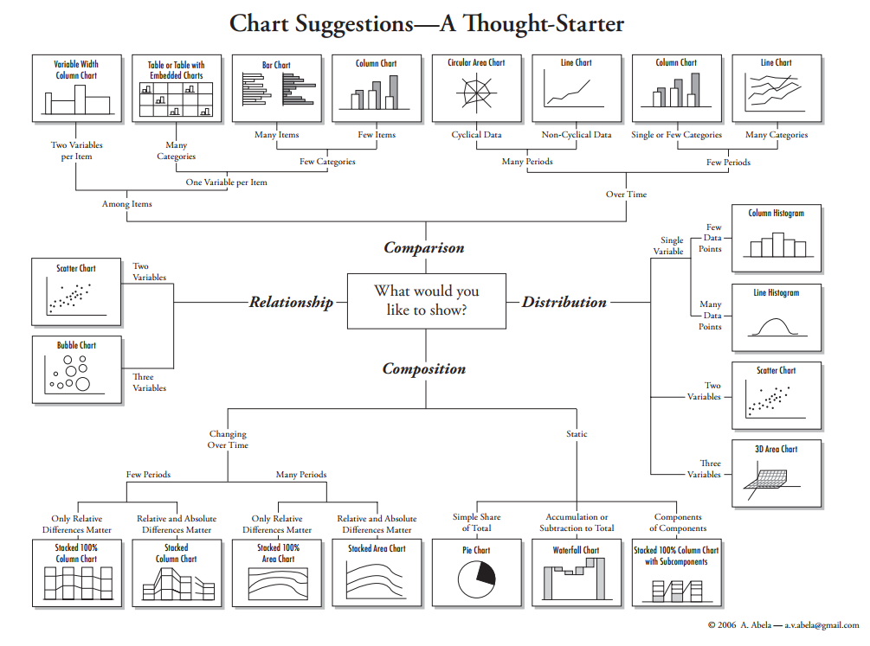

Slide 24
What do you want to show with your data?
Time Series
Ranking
Part-To-Whole
Difference
Distribution
Correlation
Map

Slide 25
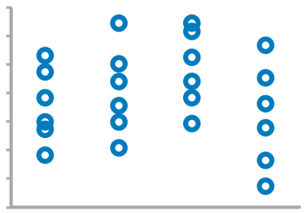
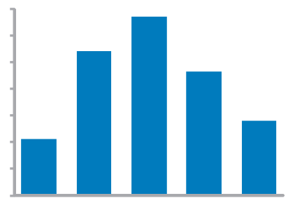
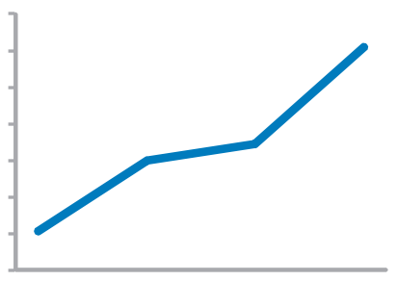
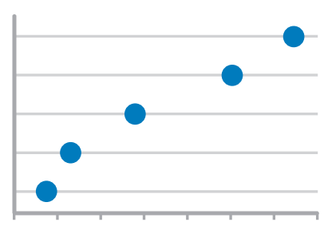
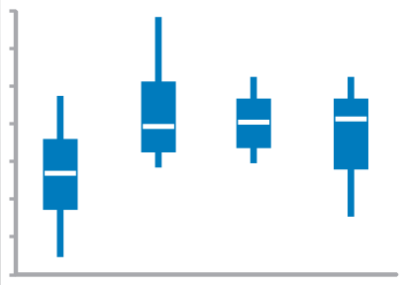
Time series values display how something changed over time
Strip Plot (multiple)
Only when also featuring distributions
Bar Graph (vertical)
To feature individual values and support their comparisons. Quantitative scale must begin at zero.
Line Graph
To feature overall trends and patterns and support their comparisons
Dot Plot (vertical)
When you do not have a value for every interval of time
Box Plot (vertical)

Slide 26
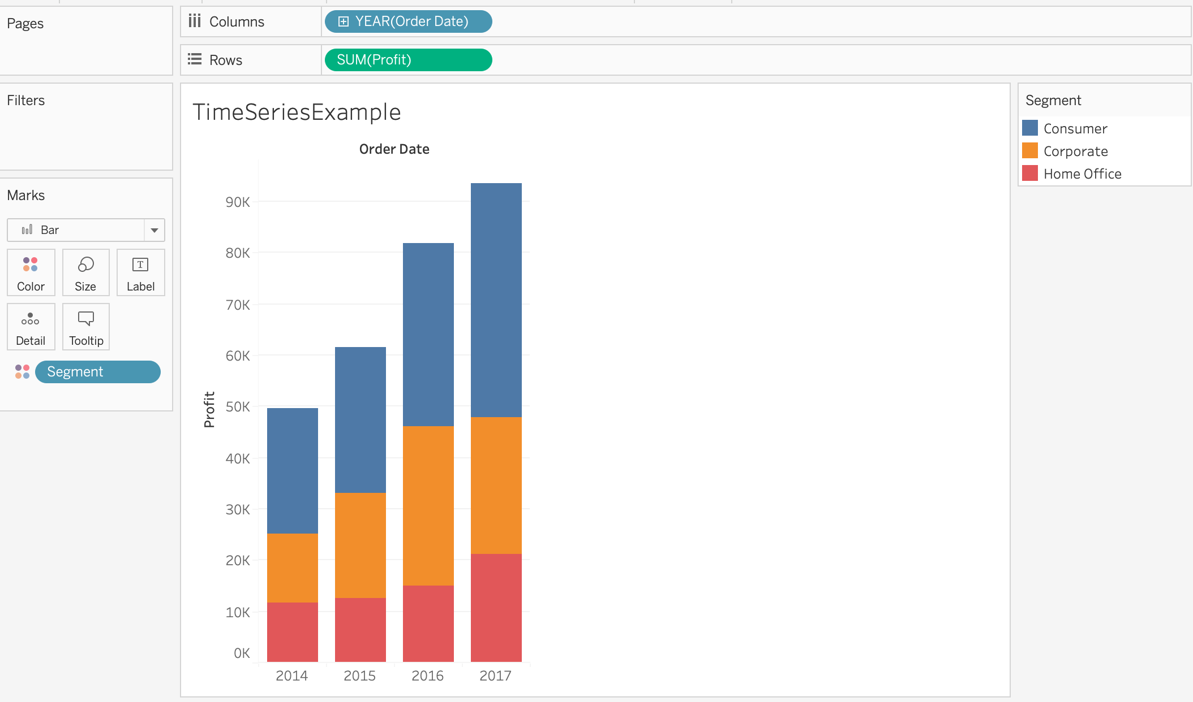
Time Series Example
Want to see profit over time, let’s build a bar graph by drag and drop Order Date to Columns and Profit to Rows.
After building the bar graph, drop Segment to Color under Marks to create stack bar plot.

Slide 27
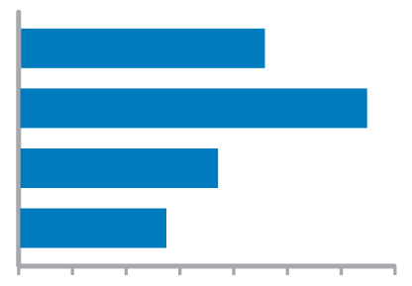
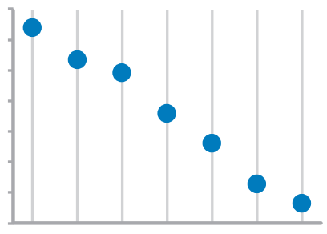
Ranking values are ordered by size (descending or ascending)
Bar Graphs
Quantitative scale must begin at zero
Dot Plots

Slide 28

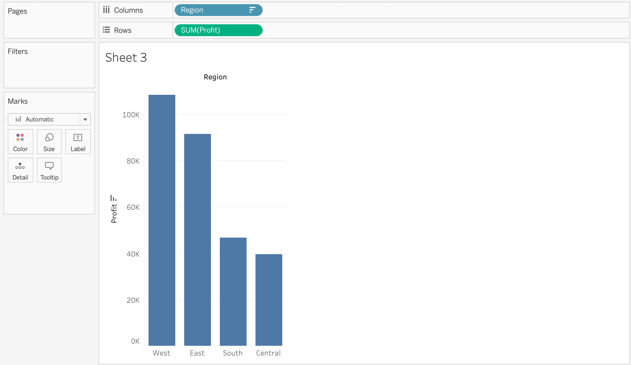
Ranking Example
Suppose want to see which region has the highest or lowest profitability, let’s build a bar graph by drag and drop Region to Columns and Profit to Rows.
After building the bar graph, click on to display in descending or ascending order.

Slide 29
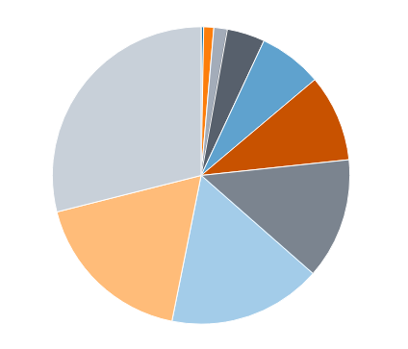
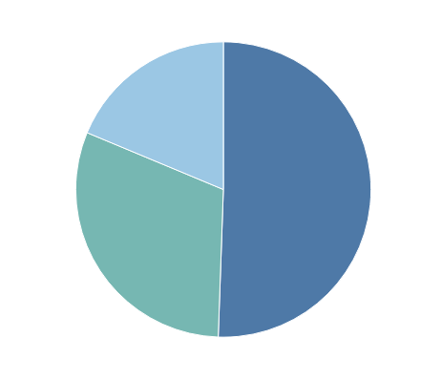
Part to Whole values represent parts (ratios) of a whole
Pie chart: commonly used to show parts of a whole
However…
Hard to judge relative size of pie slices – better at differentiating length
Take up a lot of space to present little information
Require labels and good color contrast to even be usable (often difficult)
When have one part that is a lot bigger than the other parts, pie chart can then be used to best depict the visual

Slide 30
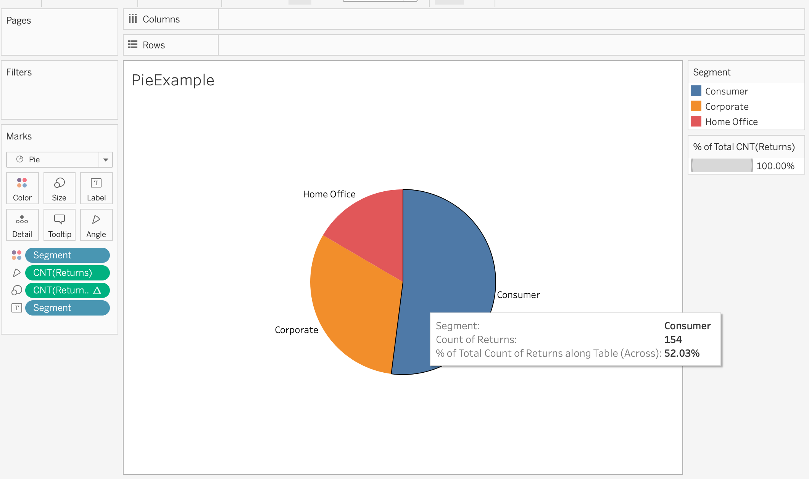
Pie Chart Example
Create a pie chart to show which customer segment has the highest return rate by drag and drop Segment into Columns and drag and drop Returns (count) into the Rows.
Go to Show Me and click on Pie Chart then drop Segment onto Label and right click on first CNT(Returns) to select Percentage of Total under Quick Table Calculations.

Slide 31
Check point: Since Tableau plots are generated by simple drag and drop into the worksheet, experiment with the dimensions, measures and other functions on the left side of the workspace to create new plots of:
Time series
Ranking (either ascending or descending order)
Pie chart

Slide 32
Difference between two sets of values
Bar Graphs
Quantitative scale must being at zero
Line Graph
Only when also featuring time series or single distribution

Slide 33
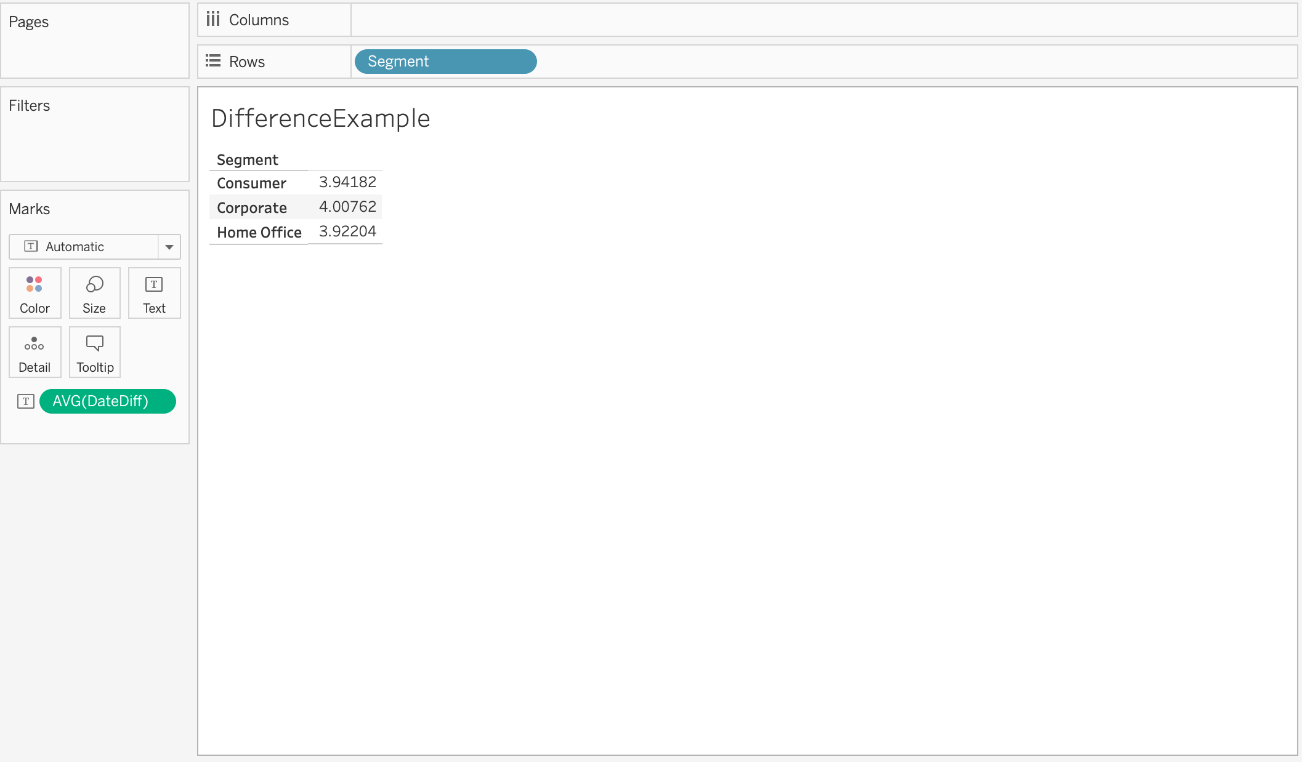
Difference Example
Create a simple table to show the average ship times for different customer segments by creating a “DateDiff” field first by going to Create Calculated Field under Analysis.
When the Calculated Field Windows open, name the field “DateDiff” and then enter
“[Ship Date ] – [Ordered Date].”
Populate table by drag and drop Segment into Columns and DateDiff into Rows.
Click on the DateDiff drop down arrow and select Average under Measure.

Slide 34
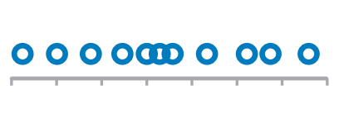
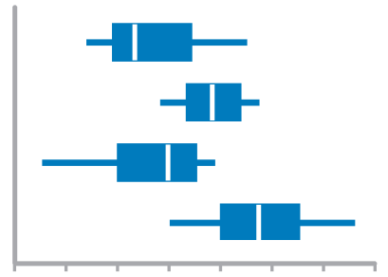
Distribution count of values per interval along quantitative scale
Strip Plot (single)
When you want to see each value
Bar Graphs
Quantitative Scale, must begin at zero
Strip Plot (multiple)
When comparing multiple distributions AND you want to see each value
Line Graph
To feature overall shape of distribution
Box Plots
When Comparing Multiple Distributions

Slide 35
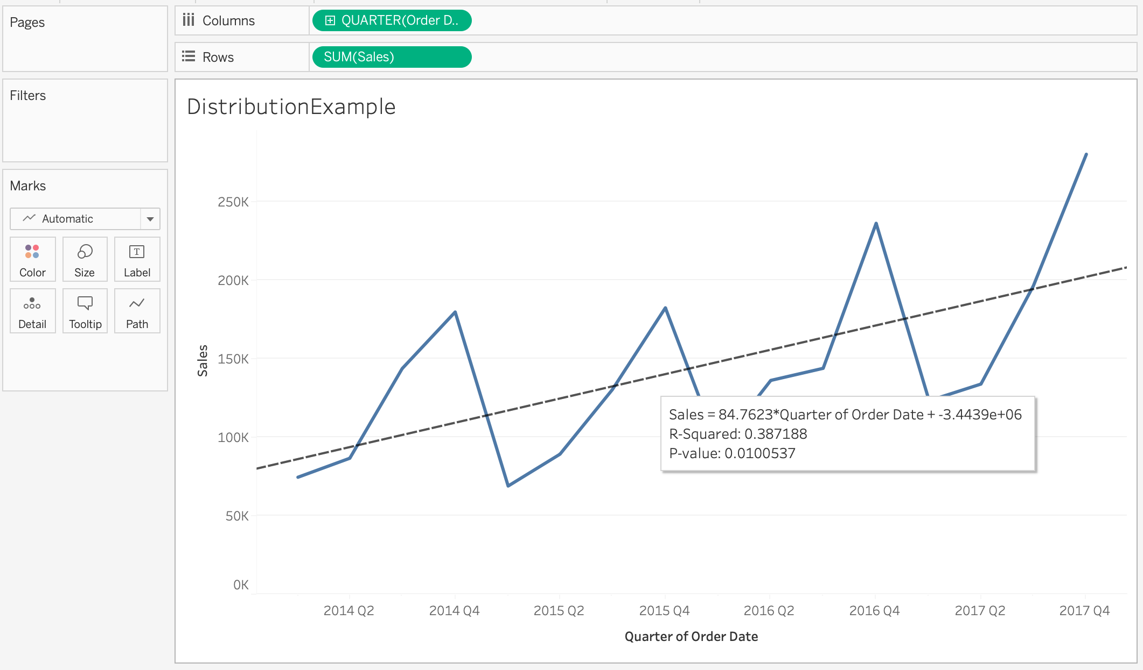
Line Distribution Example
Create a simple line distribution to show quarterly sales trend from 2014 to 2017 by drag and drop Order Date to Columns and Sales to Rows
Click on Show Me to select Line graph and change Order Date to Quarterly.
Activate trend line by selecting Trendlines under Analysis.

Slide 36
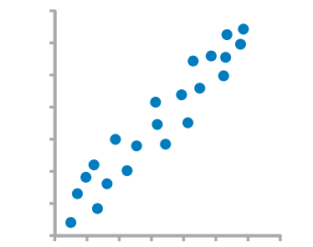
Correlation Comparison of two paired sets of values to determine if there is a relationship between them
Scatter Plot

Slide 37
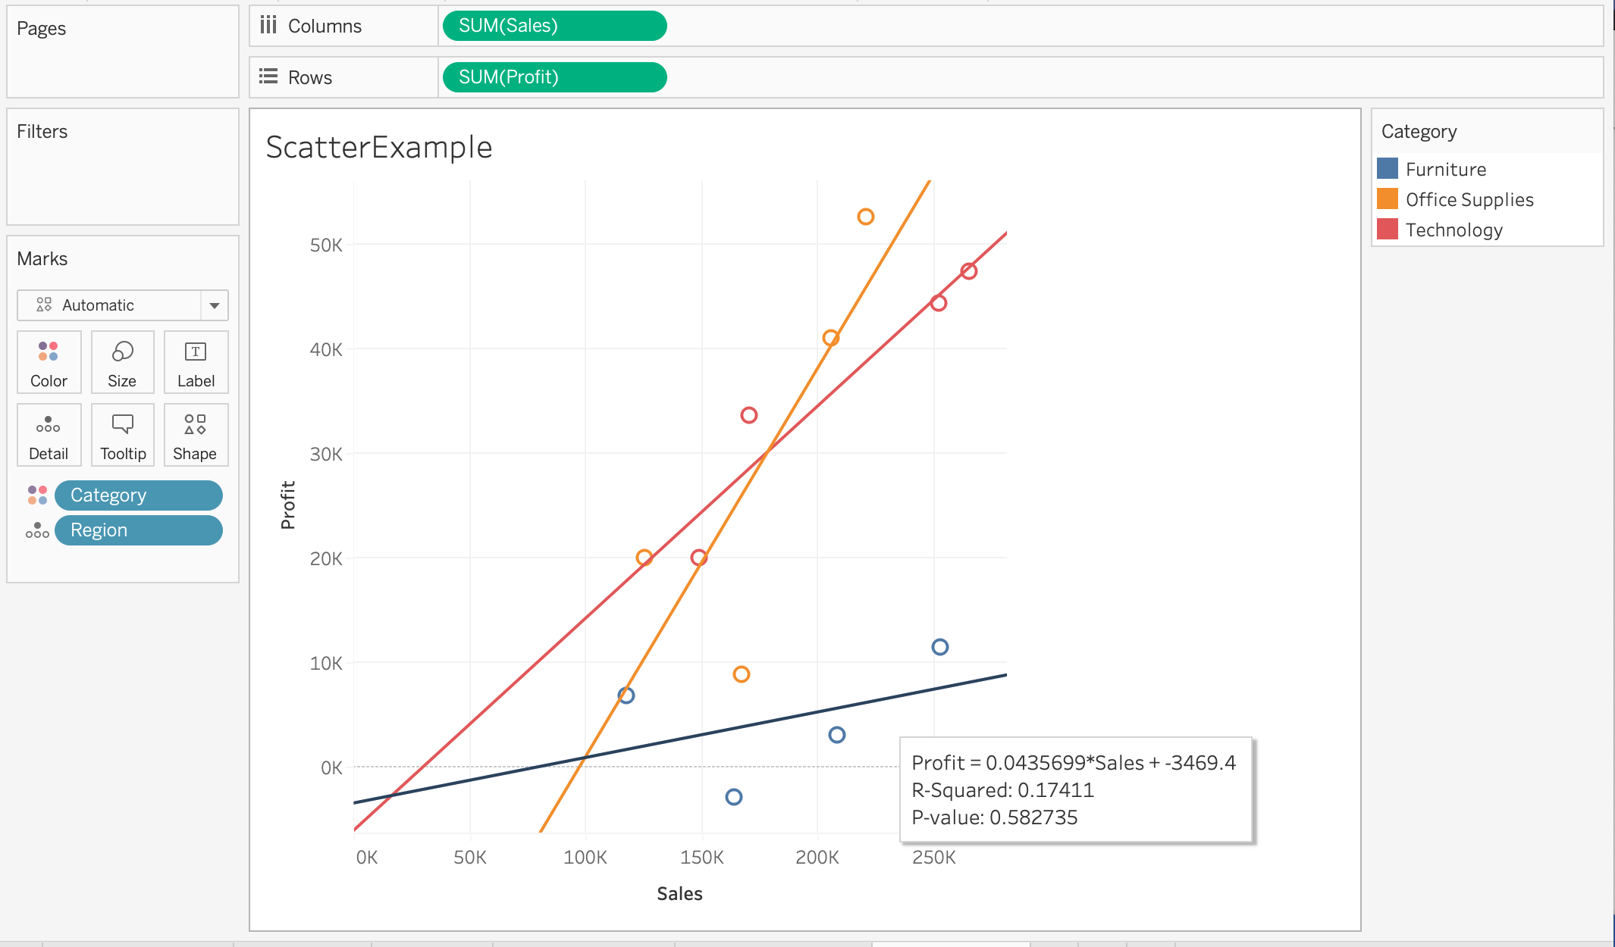
Scatter Plot Example
Create scatter plot comparing Sales to Profit by dragging Profit to Columns and Sales to Rows.
Drag Category to Colors under the Marks Card and then drag Region to Details under the Marks Card.
Activate Trend Line under the Analysis tab.

Slide 38
Basic Map Visually present the geographical region in your data
Scatter Plot

Slide 39
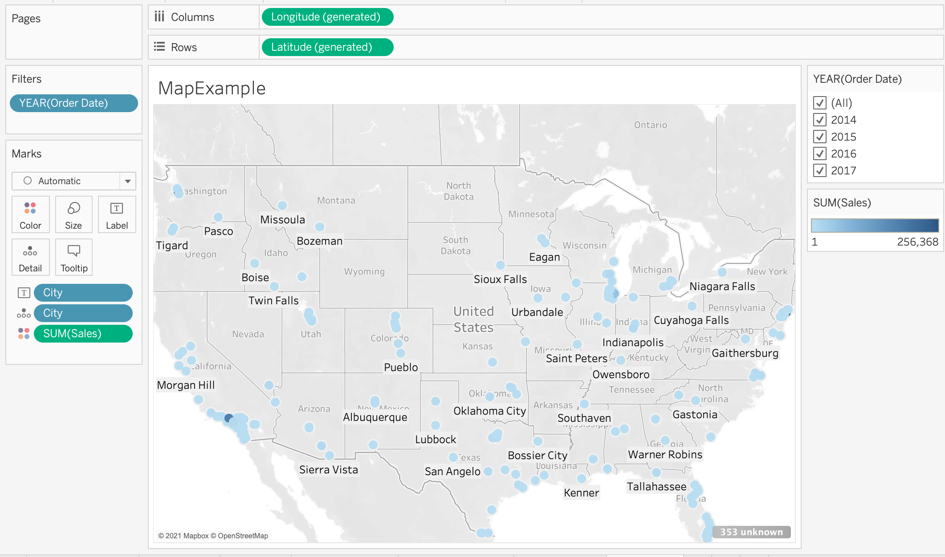
Fill Map Example
Create map by drag and drop “City” data field into the largest “Drop data field here” box.
Suppose want to create a map to see what sales are like for the cities, drag Sales into Color, then add City to Label under the Marks card.
If want to filter with Year, then drag Order date into Filters card.

Slide 40
Check point: Out of the difference, distribution, correlation, and map plots, pick two kinds of plot and create new visualizations using the measures and dimensions on the left side of the workspace:
Play around with filter, label, color etc.
Feel free to activate the trend line to show the trend.

Slide 41
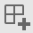
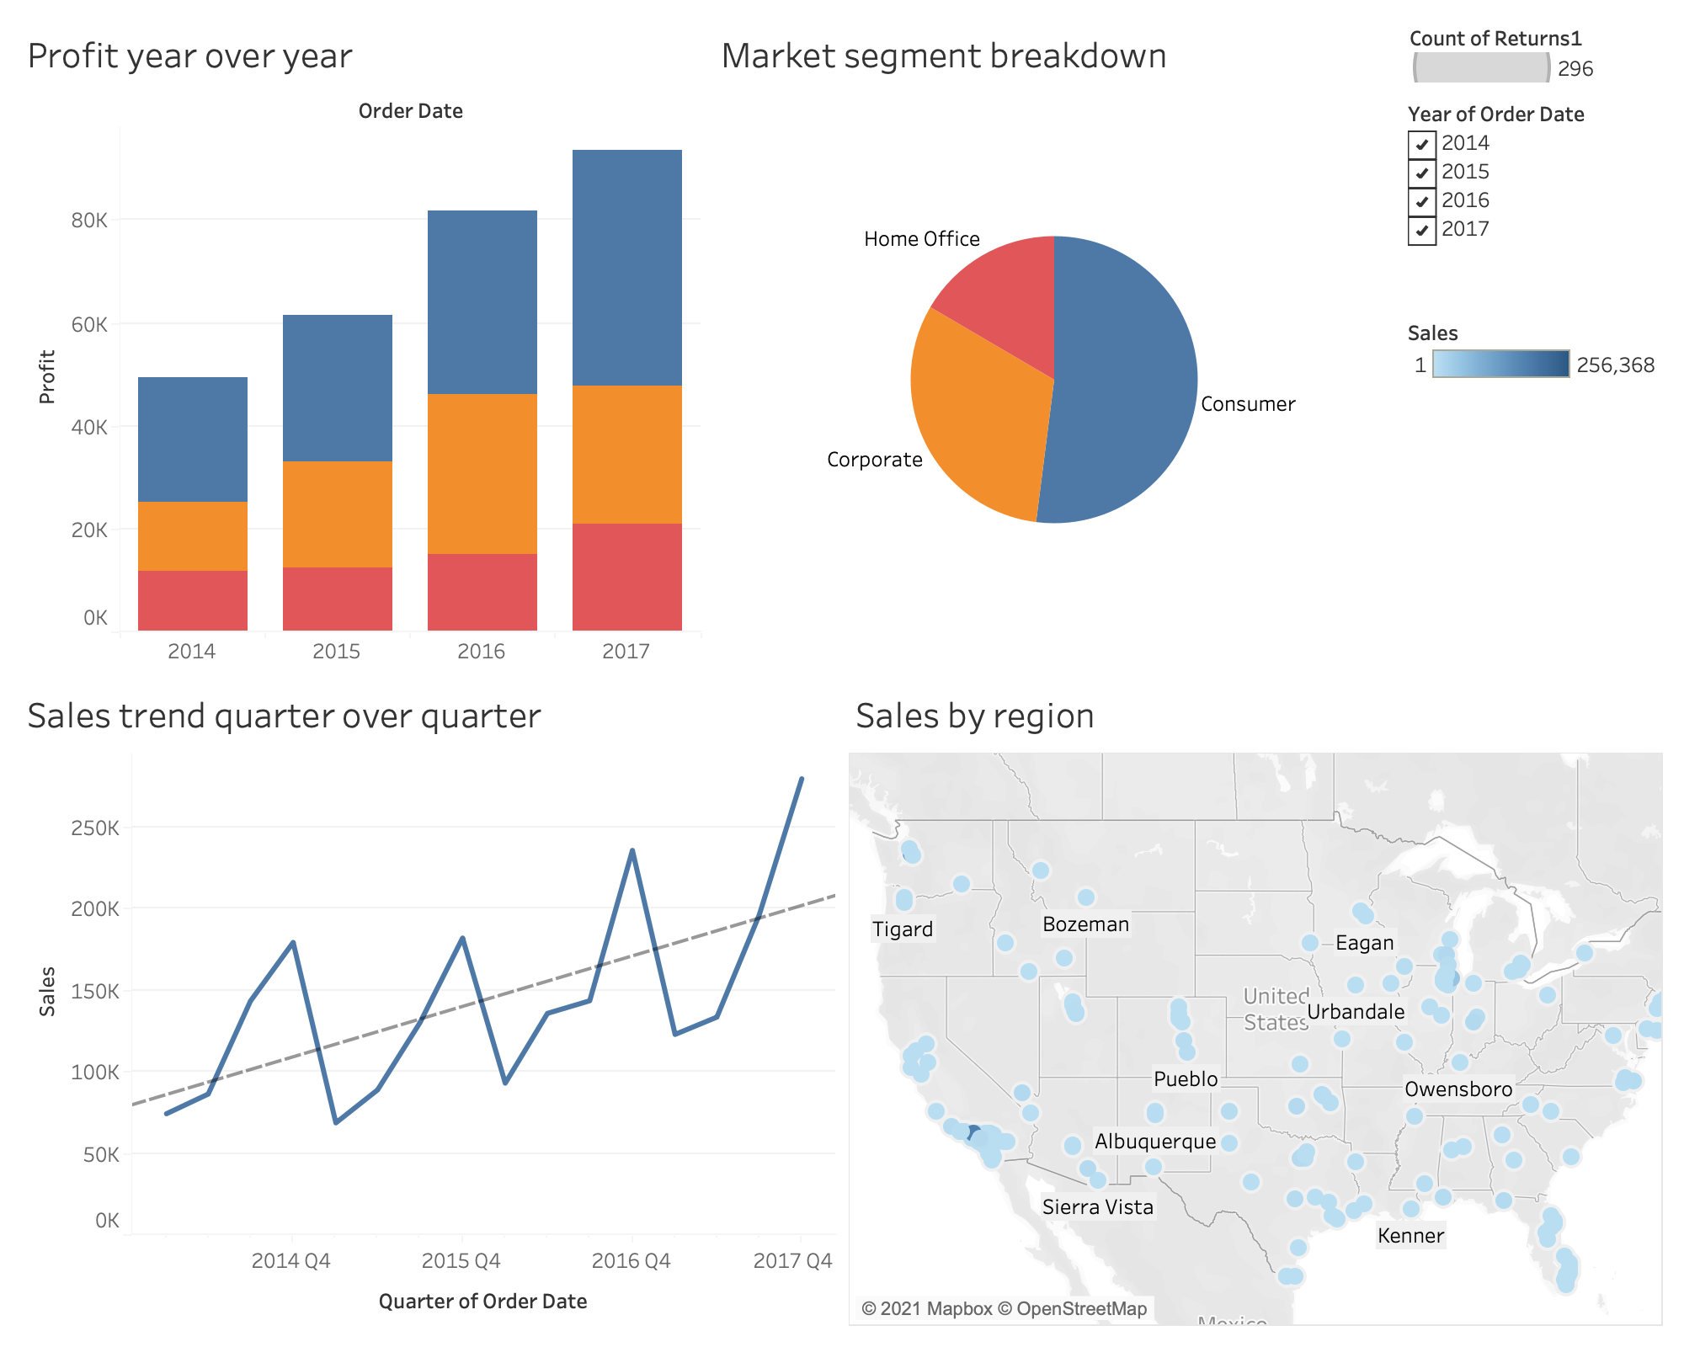
Create Dashboard
Make a dashboard by clicking on
The left panel contains the sheets that were created. Click and drag them onto your workspace. Using the arrows, adjust the sizes, fonts and layouts of the visualization.
Under the dashboard menu, select “Add a Title,” to finish off.

Slide 42
Sharing

Slide 43
Sharing
To share or present your findings the easiest way is to just export an image.
On any worksheet go to Worksheet > Export > Image…
It will give you options on Titles, Legends, Captions, and more.
If you want to show a collection of visualizations you will be better off creating a dashboard and/or a story and exporting that.
If you are collaborating with another Tableau user you can share the .twbx file or just a .twb if they have the data.
If you need your visualizations to be interactive you can publish sheets to a Tableau Server. You can make a Tableau Public account to share your visualizations publically for free.

Slide 44
Tableau Public
Example: https://public.tableau.com/profile/jeho.park4543#!/vizhome/DataVizwithTableau_0/Dashboard1
Example: http://publichealthintelligence.org/content/global-overview-magnitude-disparities-and-trend-infant-mortality-world-1950-2011

Slide 45
Hands-On

Slide 46
Significant Volcanic Eruptions
Open ‘significantvolcanoeruptions.csv’ in Tableau
A global listing of over 600 volcanic eruptions from 4360 BC to the present via Significant Volcanic Eruptions Database.
A significant eruption is classified as one that meets at least one of the following criteria:
caused fatalities
caused moderate damage (approximately $1 million or more)
Volcanic Explosivity Index (VEI) of 6 or greater
generated a tsunami
associated with a significant earthquake.

Slide 47
Significant Volcanic Eruptions (cont.)
Create visualizations to answer some of these questions:
What were the most dangerous volcanoes? (by VEI, by Fatalities)
What country has had the most significant volcanic eruptions?
Where is Deception Island located?
How many volcanoes had both an associated earthquake and tsunami?
After 1995, which year had the most deaths by volcanic eruptions?
Which volcano has the highest elevation?
Is there anything else you found interesting?
If you wish, create a Tableau Public account and publish your findings in a dashboard.

Slide 48
Further Learning

Slide 49
Further Learning: Resources
Learning Resources:
Tableau.com/learn
Explore Tableau Public
Tutorialspot
YouTube / Blog Posts
Data Sources:
Kaggle
Data.gov
Data.world
Los Angeles Open Data (https://data.lacity.org )
UCI Machine Learning Repository

Slide 50
Further Learning: Topics
Formatting
Data Cleaning
Advanced Calculations and Expressions
Advanced Chart Types
R Integration
Geospatial Analysis
Forecasting / Trend Lines / Regression

Slide 51
Thank you! Come visit us at Kravis Lower Court or email us at qcl@cmc.edu

